Slide 1
Parent/carer session
Tuesday 8th February 2022

Slide 2
Agenda
Behaviour Approach
The 5 pillars
School Rules
Our expectations
Restorative Process
Questions and Answers

Slide 3

What is our approach to behaviour at SMR?
Paul Dix – When the adults changes, everything changes
Behaviour as communication
Safeguarding

Slide 4
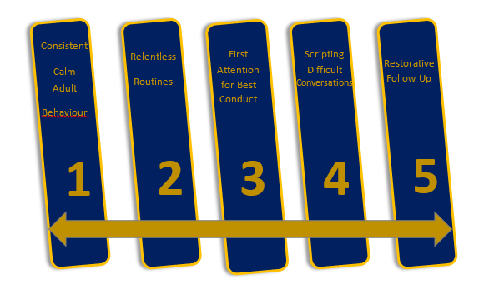
The pivotal approach

Slide 5

School rules
Safe
Mindful
Ready

Slide 6
What we expect – 8 stages
Meet and greet
Refer
Model
Plan lessons
Use
Be calm
Restore
First attention

Slide 7

Our restorative process
The Reminder
Restorative Conversation with my class teacher
The Caution
"Take a moment of time"
Last Chance

Slide 8
Consistent language
The Caution
Last Chance
Restorative Conversation with my class teacher
The Reminder
“Thank you for………………….. (listening straight away)”
“I expect…………… (to see all of the tools left nearly on the table)”
“I know you will…………………… (held Timmy to clean up water)”
“I need to see ……………….. (pick up the crisp packet)”
“You need to…………………………(speak to me at the side of the room)”
“We will………………………(try again tomorrow)”
“Remember when I spoke to you about…………………”
“This is what I expect”
“Thank you”
“I have noticed….”
“You know our rule about….”
“Do you remember when?.........”
“That is the behaviour I need to see”
“Thank-you for listening”
“What happened?”
“What were you thinking at the time?”
“How did this make people feel?”
“What has been affected?”
“What should we do to put things right?”
“How can we do things differently in the future?”

Slide 9
Q&A

