Slide 1
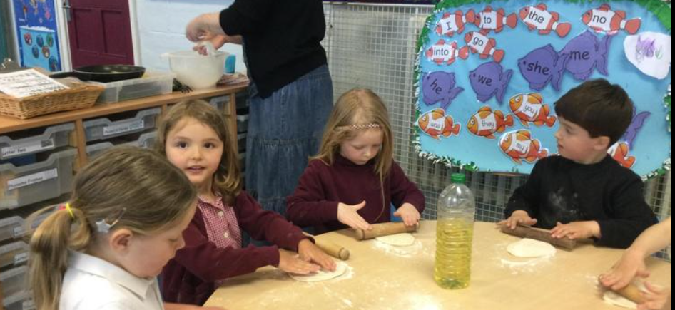
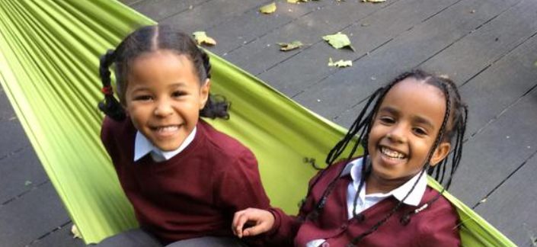
Reception Parents Meeting
Monday 24th May 2021

Slide 2
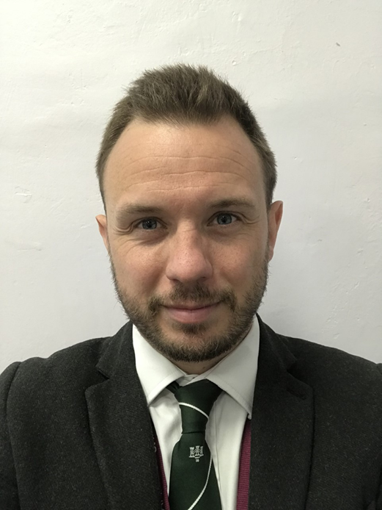
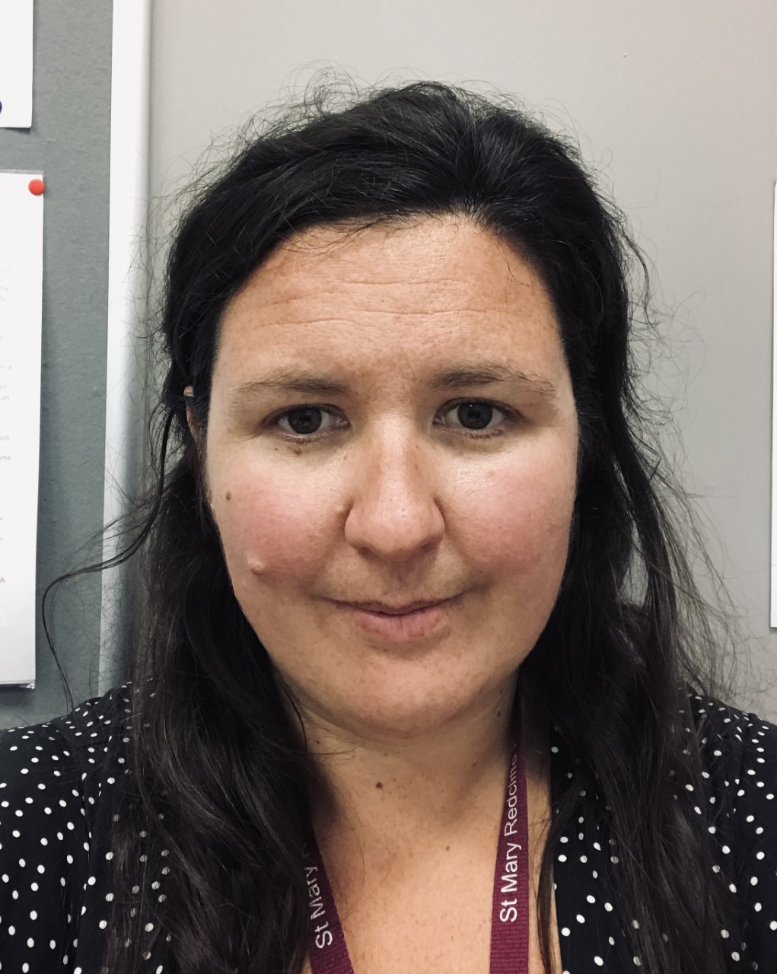
Staff
Assistant Head- Mr Jones
Early Years Lead in September- Mrs Birch
Teachers and LSAs- Mrs Birch and Ms Radnor, Ms McNab and Mrs Knights
Admin Support- Alex Maxwell and Avril Stocks
Family Link Worker- Chris Williams
Mr Fry
Co-Head of School
Miss Dudding
Co-Head of School

Slide 3


St Mary Redcliffe Primary School
Rooted in Love

Slide 4



Our Academy Trust

Slide 5
Welcome from our EYFS Lead

Slide 6
The School Day (example)
8:45- Start of the day and register
9:10- Phonics
9:30- Phonics Catch up and Handwriting
9:45- English Groups and Free Flow
10-45-Snack
11:00- English
11-40-12-40- Lunch Time
12-40- Maths
1:15- Guided Reading
1:15- Free Flow
2-45- Story Time
3:20- End of the day

Slide 7
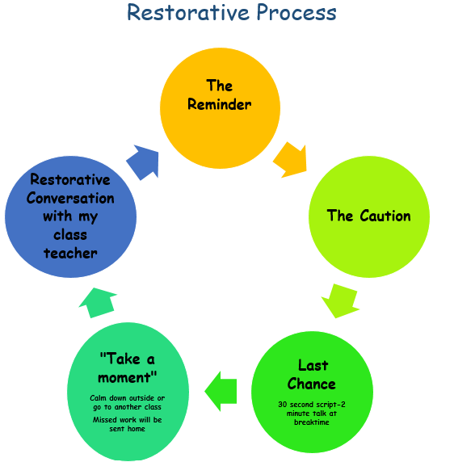
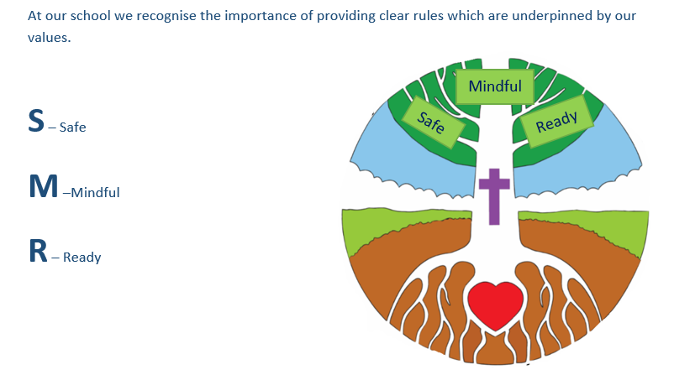
Behaviour Policy
https://www.stmaryredcliffeprimary.co.uk/behaviour-1/

Slide 8
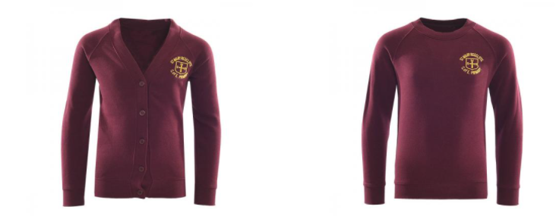

School Uniform
https://www.monkhouse.com/c/4494/St-Mary-Redcliffe
The PTA usually run a ‘Tea and Tissues’ event for you to meet other parents.
There will be used school uniform here.
Information will follow later in the year.

Slide 9

Snack Time
Fresh fruit or vegetables are provided for every child in Reception each day.
Milk is available until the term in which your child has his/her 5th birthday, therefore water is provided.

Slide 10
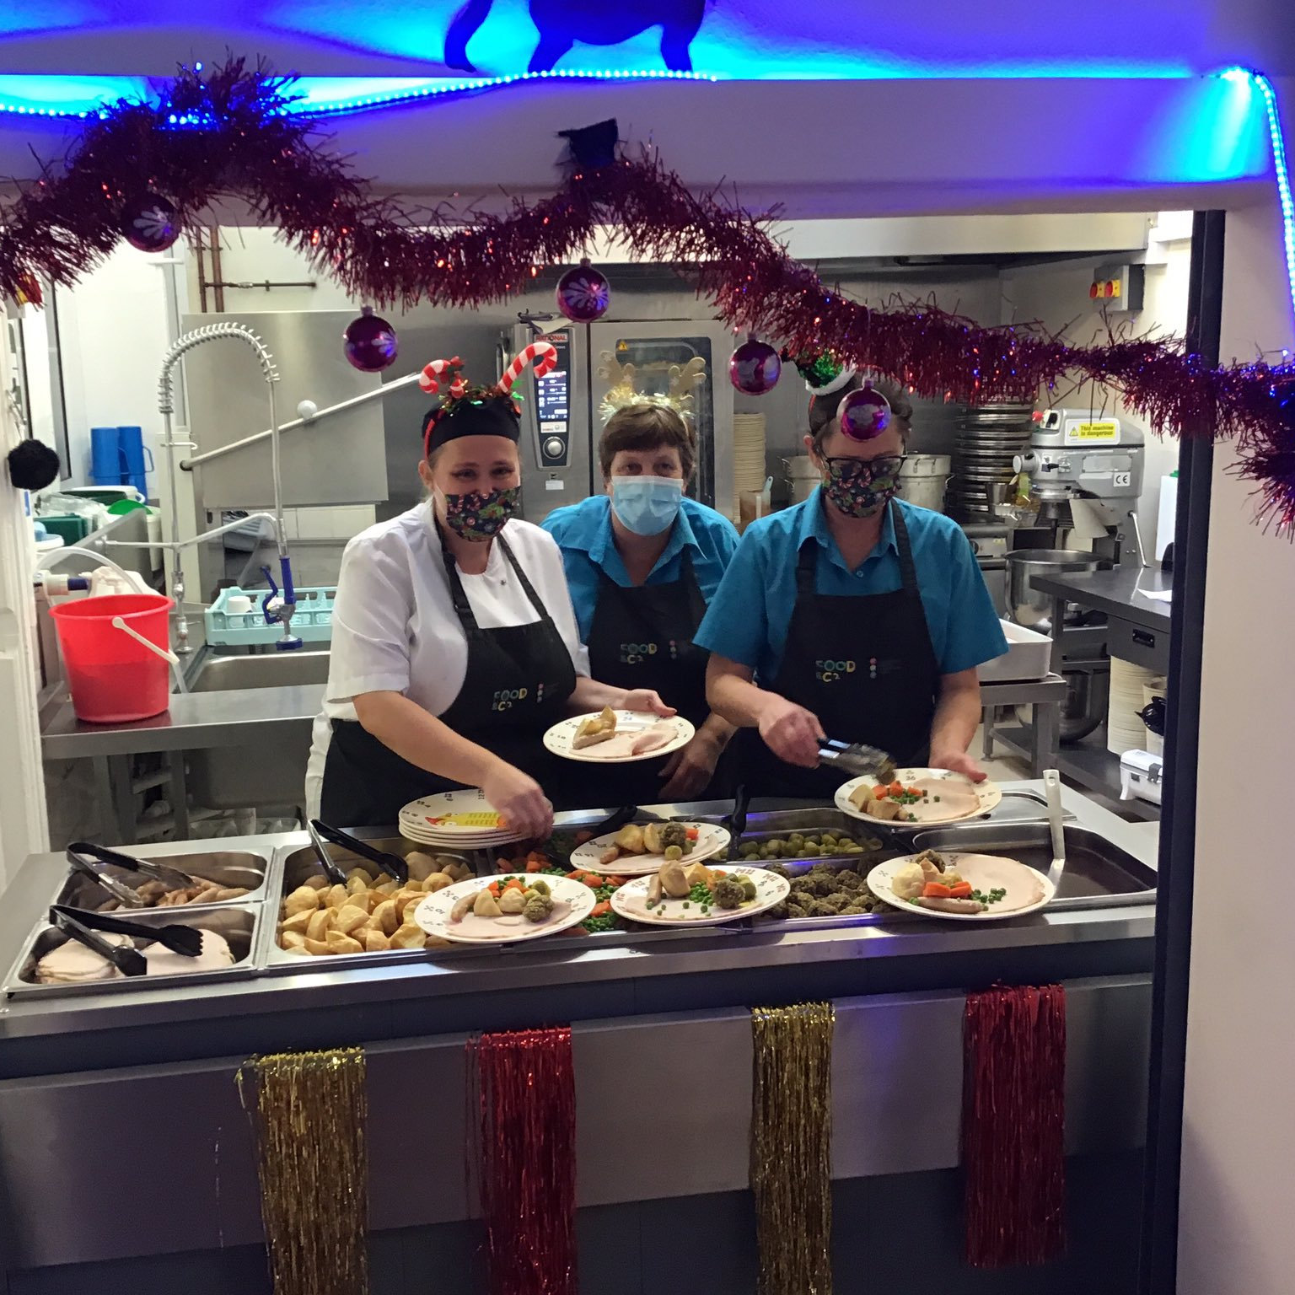
Lunch Time
School dinners provided by Sodexo
School meals must be booked and paid for in advance online https://login.schoolgateway.com/0/auth/login or using the schoolgateway app, the cost is £2.30 per meal.
Children in Year's Reception, Y1 and Y2 are under the Universal Free School Meals scheme.
3 Week Menu

Slide 11
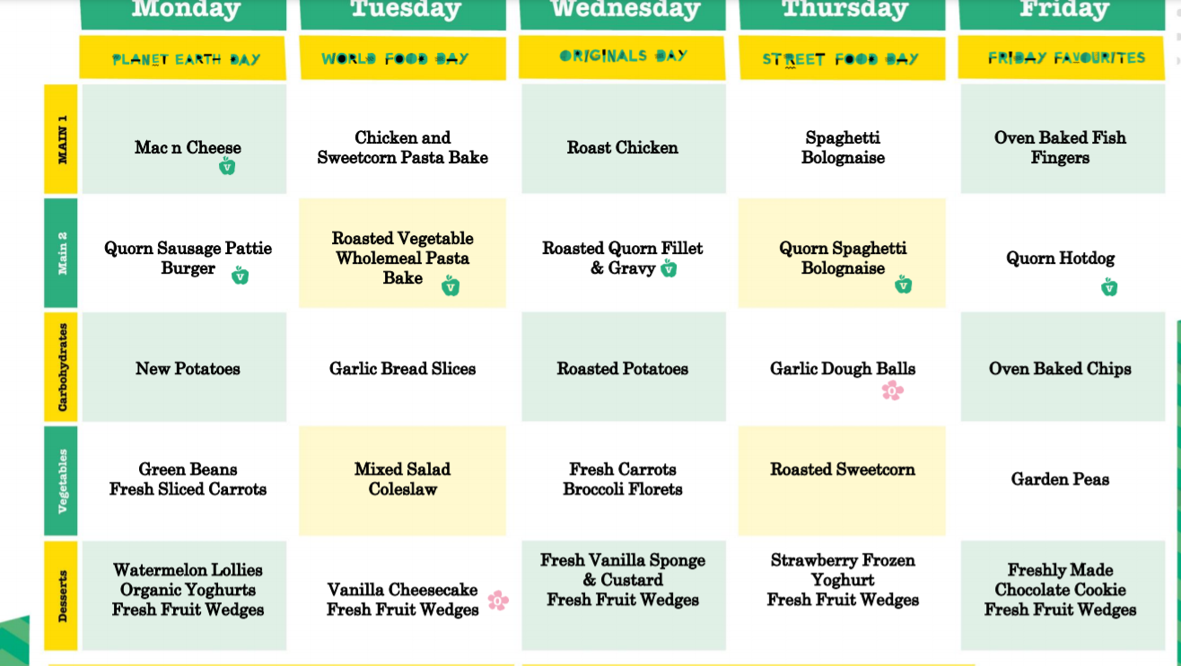

Slide 12
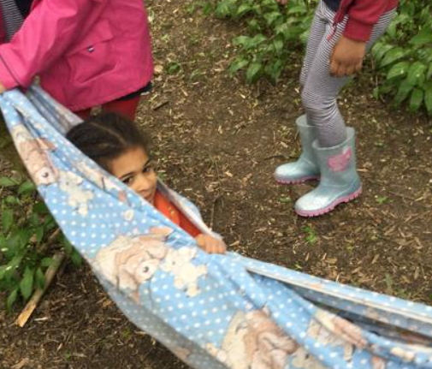
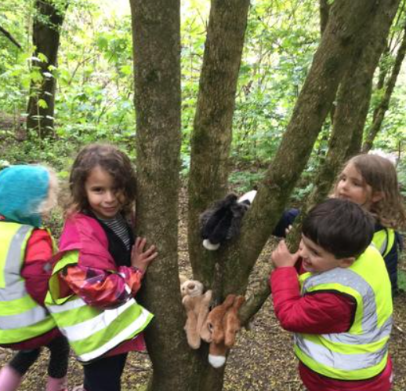
Forest School
Children in Reception will do Forest School throughout the year. This usually starts in term 2 once the children are settled.
Forest School site located in the park near the school
We ask for parent volunteers
Children come into school in forest school kit
You will have more information when this starts

Slide 13
Communication
Regular Friday newsletter to parents
Send letters out by emails, text reminders and messages all by School Gateway
Website- Class Pages are updated regularly and the website is kept up to date with letters, dates for your diary and class pages.
You can pay for meals and trips via the School Gateway system.
Once your child has started, please log in to Gateway on www.gateway.com and follow the registration instructions.
You can use Gateway online or as an App on your phone.
If you don't register you will miss important messages from school

Slide 14


Transition
Staff are currently working with Nurseries to gather information about children joining.
Teachers will organise children into classes – Elm and Ash Class
Children will be split into Groups 1 and 2 for each class.
We will send groups and times by Monday 14th June
Stay and Play – This is an opportunity for you and your child to visit the classroom and meet the staff. This will be in smaller groups to give the children time to settle. You will be emailed time slots.
Monday 5th July
Wednesday 7th July
Home Visits/Meet the Teacher – Teacher and LSA will come to visit you and your child to get to know you. You will be emailed a time slot on one of the days during this week.
Week of the 12th July

Slide 15

Children will be split into Groups 1 and 2
Week 3- 20.0.21- Children in full time 8:45-3:20
Week 1 6.9.21-10.9.21 | Group 1 | Group 2
Monday | 8-45- 11-45 | 1:00-3:20
Tuesday | 8-45- 11-45 | 1:00-3:20
Wednesday | 8-45- 11-45 | 1:00-3:20
Thursday | 8-45-11-45 | 1:00-3:20
Friday | 8-45- 11-45 | 1:00-3:20
Week 2 13.9.21-17.9.21 | Group 1 | Group 2
Monday | 8:45- 12:00 | 1:00-3:20
Tuesday | 8:45- 12:00 | 1:00-3:20
Wednesday | 8:45- 11-45 | 1:00-3:20
Thursday | 1:00- 3:20 | 8:45- 12:00
Friday | 1:00- 3:20 | 8:45- 12:00

Slide 16
Important Paperwork
This has been emailed to you, please complete and send back by Monday 7th June.
If you require a paper copy, please drop into the office.
We will be sending out a welcome leaflet with information shortly.
All children in Reception are entitled to free school meals, but we ask for parents to complete the data collection form so we can check eligibaility of Pupil Premium funding. This funding goes directly to the school to support your child in terms of extra intervention, support, trips and wrap around care.

Slide 17
FAQ
What is the schools approach to collective worship and RE?
We are a Church of England School so we have collective worship daily through different forms (e.g. singing, celebration). Children are invited to pray or have a moment or reflection as we have a very diverse community at our school. Children will do RE lessons which cover a range of faiths and throughout time at SMR will have the opportunity to visit places of worship.

Slide 18
FAQ
What is the school's attendance policy?
We believe that regular attendance supports every child's progress in their learning and social interactions with their friends. Therefore, coming to school every day is vitally important.
Holidays during term time will be unauthorised. If term time absence is requested for other reasons, the school will ask for evidence (eg. Doctor's note).
The Walking Bus – Every morning, there is a walking bus from the Redcliffe Children's Centre where the children are collected at 8am and walked to school. The children will then join breakfast club for free and enjoy a smooth start to the day.

Slide 19
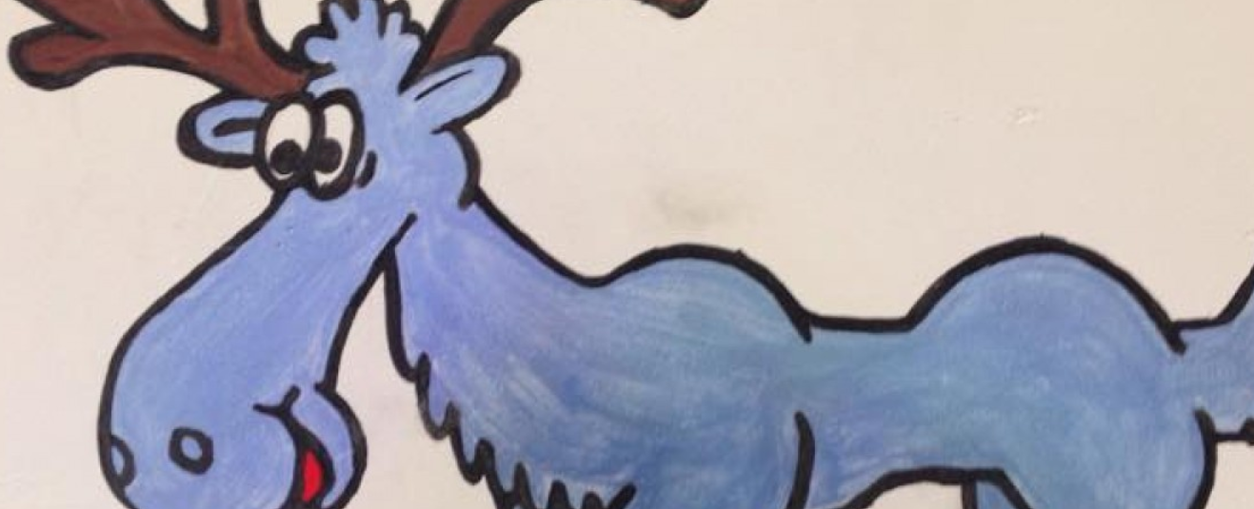
FAQ
Do you provide wrap around care?
After-School Club
We work with Moose Club who provide an After-School Club held at Victoria Park School. Staff members from Moose and 2 staff from SMRP walk the children over to Moose Club.
Please contact Moose Club directly for more details
http://www.moosekidsclub.co.uk/moose-after-school-and-holiday-club/about-moose/
Breakfast Club
We run our own Breakfast Club. This opens at 8:00 and is run in the hall. Parents must book this provision using School Gateway. Sessions at £2.50. If your child is pupil-premium, this can be paid by the school.

Slide 20
FAQ
Are parents allowed to come into class?
Throughout the year, the school will host a number of 'curriculum afternoons' where you will be able to come into school to see what your child is learning.
Furthermore, we will always be asking for help for educational visits and forest school days. We would love your assistance!

Slide 21
FAQ
How will the school support my child who has additional needs?
You will have an opportunity to meet with the Class Teacher where you can share information about your child. The school are already in conversation with Nurseries who are passing information onto us to support transition. The school will work with you to support your child's needs, some children will have a Pupil Passport which has targets specifically tailored to your child, this is reviewed throughout the year.
We have our own SENCO called Liz Radnor and a Nurture and Inclusion Lead, Ruth Knights. The school has a Speech &Language therapist for ½ a day a week and works closely with other agencies to assessment and support children.

